Slide 1
Fingerprint based Exam Hall Authentication System
Project No.: 16CSEG112
Project Incharge: Ms. Garima Turan
Other Teachers who gave input: Mr. Paramjit Singh
Team Members: Kriti Shahi,Lokesh,Malkeet Kaur,Mannat Kaur

Slide 2
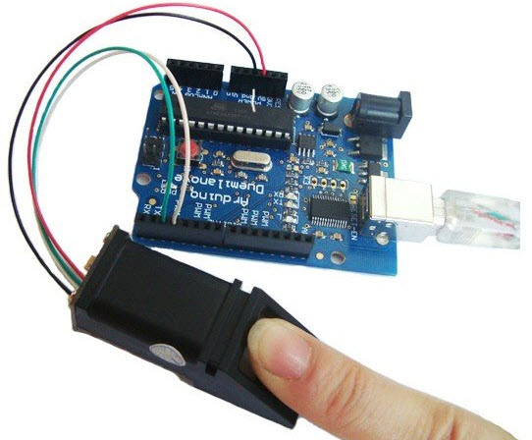
Project Statement
This system is designed to pass only users verified by their fingerprint scan and block non verified users. Our system consists of fingerprint scanner connected to microcontroller circuit. The system allows to register the users via finger through the fingerprint scanner. During login, the storage unit compares fingerprint with the pre stored data and displays the information.

Slide 3
INTRODUCTION
Nowadays accurate personal identification is becoming more and more important. Currently fingerprint recognition is the most widely used technique for personal identification. These finger print sensors exploit different techniques to acquire the image (pressure, electrical field, temperature…) and require a static (matrix sensor) or mobile finger position (sweeping mode sensor).
Fingerprint recognition or fingerprint authentication refers to the automated method of verifying a match between two human fingerprints

Slide 4
LITERATURE SURVEY
Biometrics is the use of measurable, biological characteristics such as finger prints or iris patterns to identify a person to an electronic system. Once these measurements have been taken, they may then be used to authenticate an individual or user. This is done by comparing the sampled biometric against a template taken earlier. This process will be discussed in further detail below. Although biometrics is viewed as an emerging technology, in reality, their use has been documented throughout the history of mankind. In Egypt, thousands of years ago, it was common for individuals to use physical traits or characteristics such as scars, eye and hair color, height, etc., to identify individuals for business transactions.

Slide 5
PROgress OF project

Slide 6
MATERIALS BOUGHT FROM THE ELECTRONIC SHOP
ARDUINO UNO R3
LCD DISPLAY
BREADBOARD
FINGERPRINT SENSOR
JUMPER WIRES
10 KΩ POTENTIOMETER
220 Ω RESISTORS
PUSH BUTTONS

Slide 7
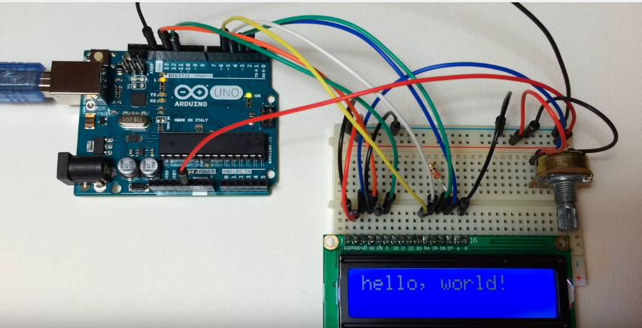
Setting up the lcd display on Arduino board
The 16×2 LCD on the Arduino board has been set up by us.

Slide 8
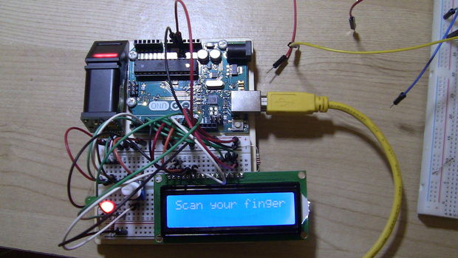
Connecting the fingerprint sensor

Slide 9
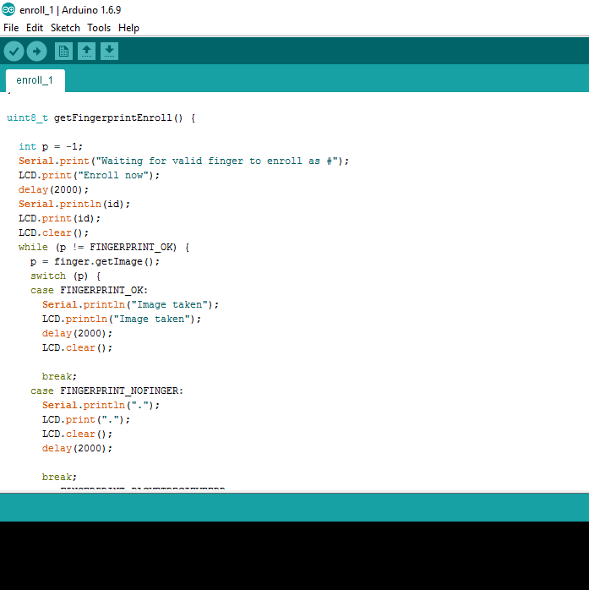
CODING
The coding is done in Arduino IDE.
The codes of fingerprintsensor has been taken from Github.
The commands of LCD display has been given by us.

Slide 10
Summary
Fingerprint is the cheapest, fastest, most convenient and most reliable way to identify someone. Fingerprint authentication has many advantages over traditional systems such as passwords. The greatest strength of Fingerprint recognition is its greatest liability. Today, fingerprint recognition technology is used for security purposes, to restrict access or to protect computers. As fingerprint recognition technology develops, it is expected that more affordable and more portable fingerprint recognition devices will become available, and finger-print recognition will be considered a safe and convenient personal identification system. Eventually, fingerprint recognition will be used to secure the safety and reliability of a variety of businesses in the industrial sector including the personal devices and financial industry.

Slide 11
Thank you

